Slide 1
Presentation On
News Empire
Prepared By: Baljeet Singh
Jaswant Singh
Dheeraj Sahni

Slide 2
Project Objective
To provide single source of news reading with different categories according to viewer’s choice with responsive design.

Slide 3
Introduction
Simple news aggregator
Responsive design
Read news from the comfort of your browser
Read news by categories
Links to the actual news source

Slide 4
Technology Used
Php (php hypertext preprocessor): Features:
Simple & Secure
Portable
Server Side
High Performance

Slide 5
Technology Used (contd.)
MySQL : Features:
Simple & Secure
Portable
Easy to use
Open Source
Free
Cross Platform

Slide 6
Other Technologies Used
Html
Css
Jquery
Bootstrap
Reveal.js

Slide 7
Requirements to Run
You need to have browser installed on your system. viz. Chrome, firefox, IE.

Slide 8
Project Structure
Home
Technology
Entertainment
India
Programming
Web Dev
Quotes
Mobile
Sports
Entertainment
World

Slide 9
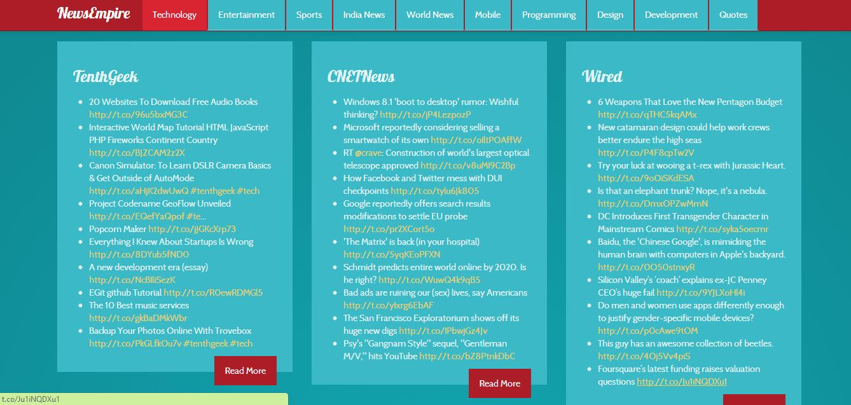
Technology Section

Slide 10
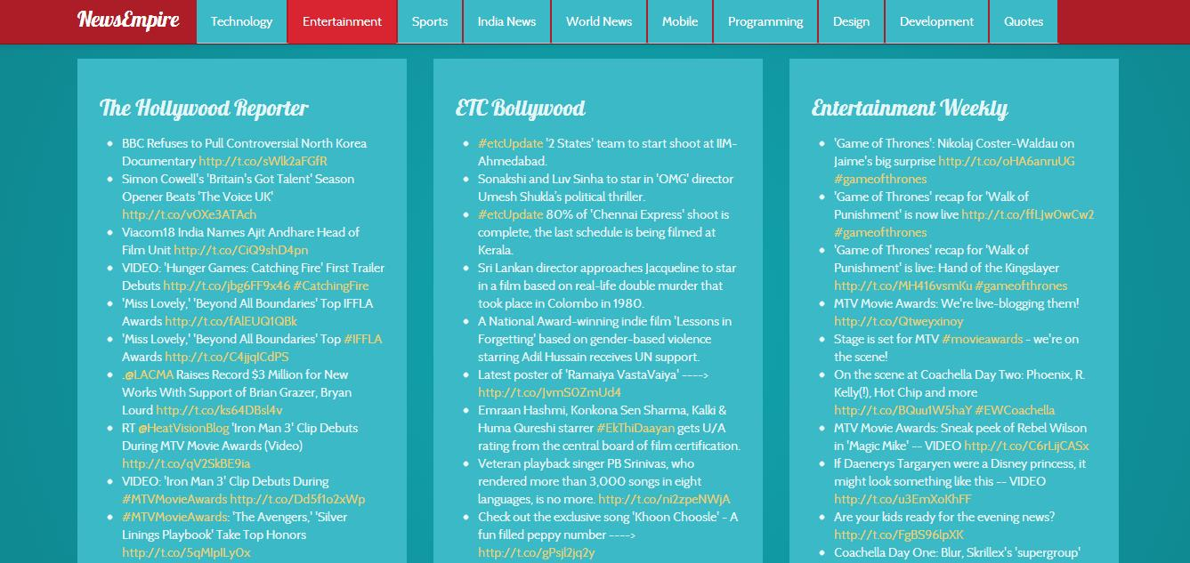
Entertainment Section

Slide 11
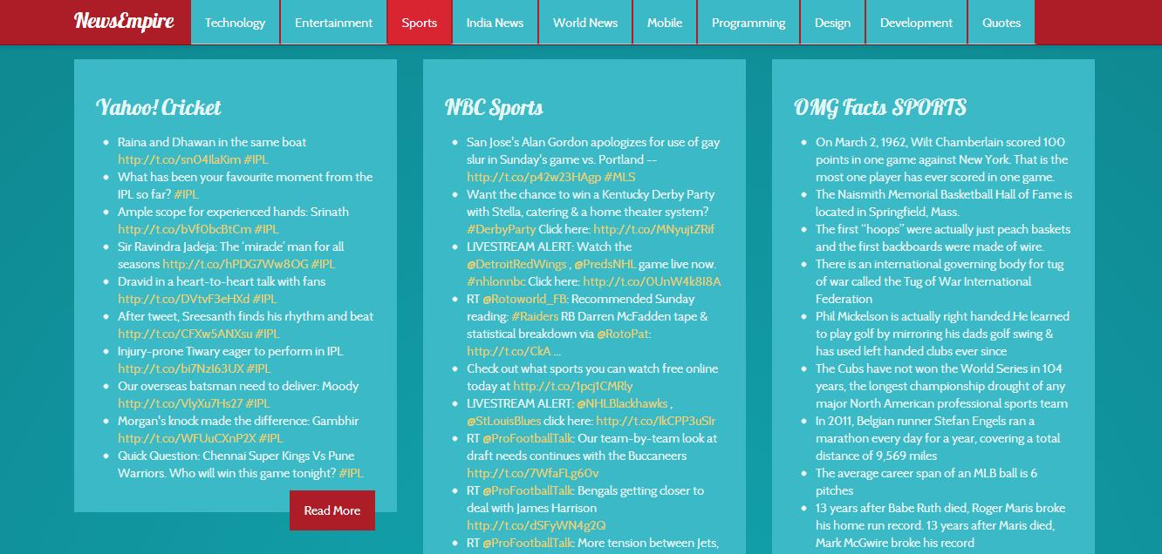
Sports Section

Slide 12
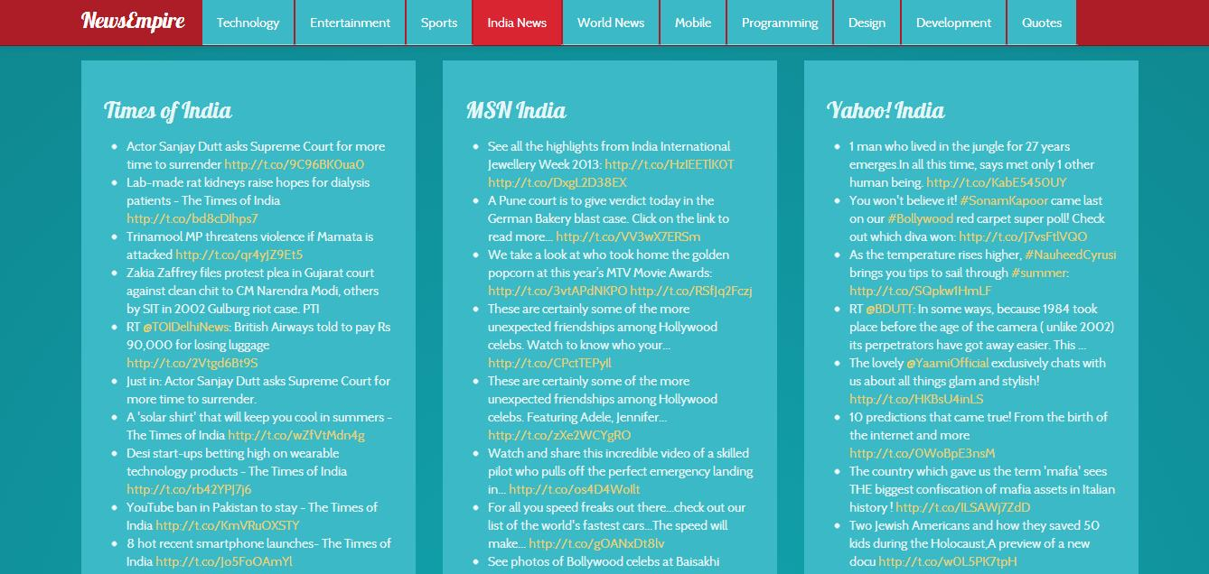
India News

Slide 13
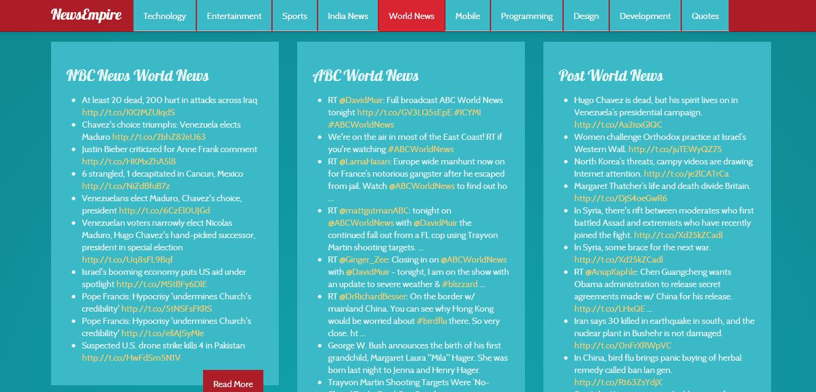
World News

Slide 14
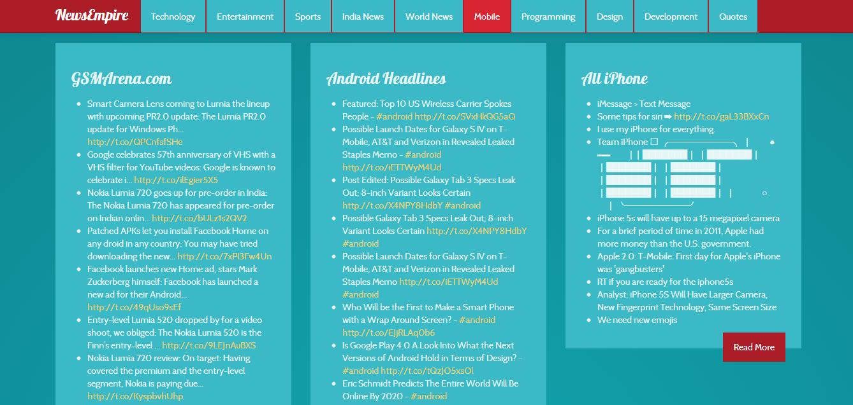
Mobile Section

Slide 15
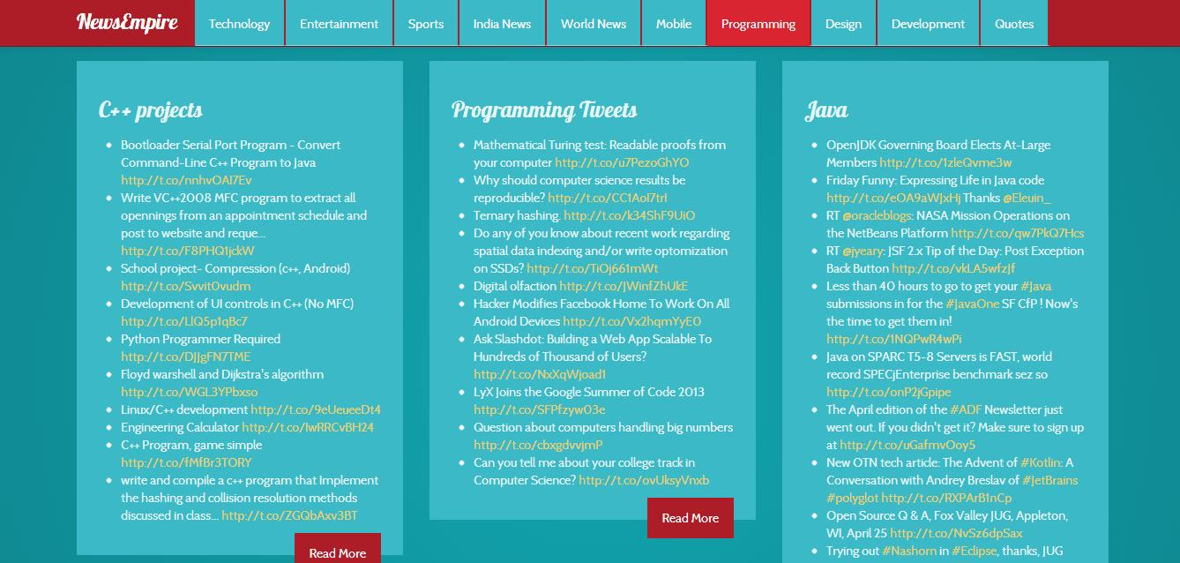
Programming Section

Slide 16
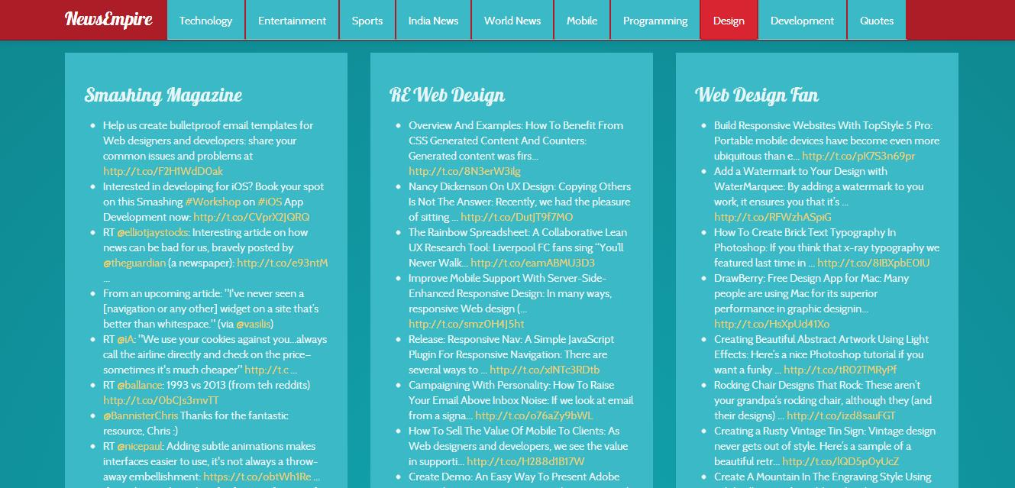
Design Section

Slide 17
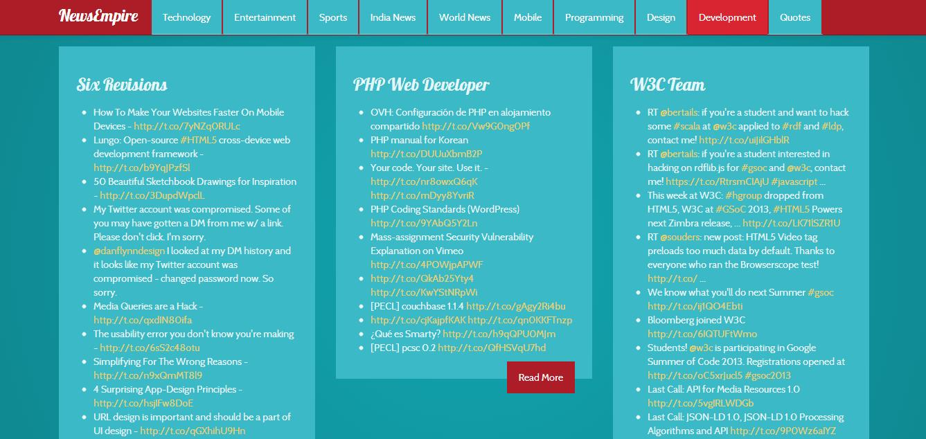
Development Section

Slide 18
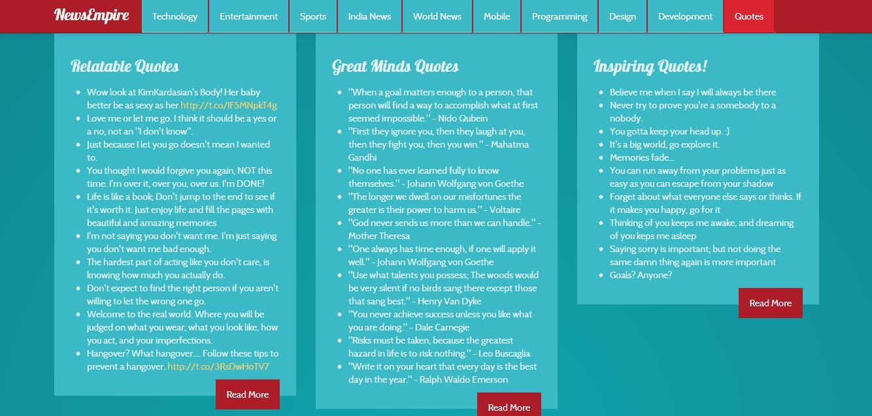
Quotes Section

Slide 19
Features
Single news aggregator for all type of news
Simple interface
Easy to understand
Cross platform

Slide 20
Conclusion
Thus newsempire provides the complete solution for all types of news around the globe with simple interface.

Slide 21
FINISH.......Now let's look at the project

